Slide 1

App count down timer
cuong@techmaster.vn

Slide 2
Possible user interactions (verbs)
User selects amount of time to count down
User starts count down by tapping button 'Start’
User pauses count down progress by tapping button 'Pause’
User resets count down by tapping button 'Reset’
User stop alarming sound by tapping button ‘Reset’

Slide 3
Variable to observe
State of app:
Ready: when user dials the slider to set count_down value.
Reset: App bootups or user just tap reset button count_down = 0
Running: count_down will gradually decreases to zero.
Paused: count_down temporarily stops.
Alarm: count_down reaches to zero.
count_down: number of seconds to count down to zero

Slide 4
States of the app
State | Button 1 | Button 2 | User can
Reset |  |  | count_down = 0 Dial slider to set amount of count_down then transit to “Ready” state
Ready | Start |  | User still can dial slider to change count_down value Tap button “Start” to transit to “Running” state count_down > 0
Running | Pause | Reset | Slider is disabled, cannot dial Tap button “Pause” to transit to “Pause” state Tap button ”Reset” to transit to “Reset” state count_down decreases to 0
Paused | Start | Reset | Tap button “Start” to resume count down Tap button ”Reset” to transit to “Reset” state
Alarm |  | Reset | Tap button ”Reset” to transit to “Reset” state

Slide 5
count_down = 0
Reset
Dial slider to set count_down
Ready
Dial slider to set
count_down to new value
Tap button “Reset”
Tap button “Start”
Running
Tap button ‘Reset”
to stop alarming sound
Tap button “Pause”
Tap button “Start”
Alarm
count_down reaches 0
Paused

Slide 6
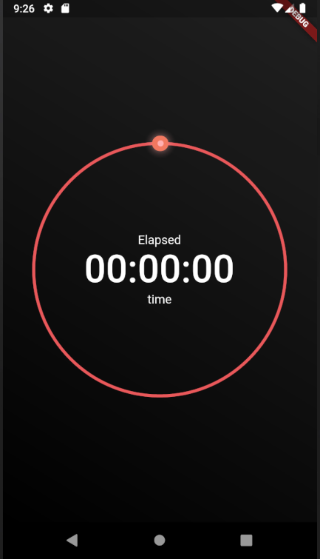
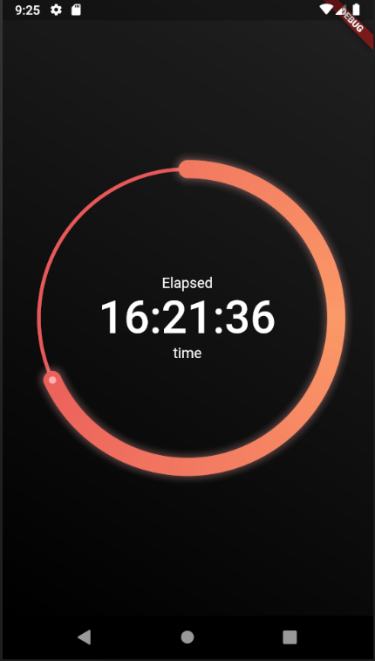
Start
“Reset” state
“Ready” state

Slide 7

Pause
Reset
Start
Reset
Reset
“Running” state
“Paused” state
“Alarmed” state

Slide 8
Steps to do

Slide 9
Different app states approaches
Custom stateful widget: Easy code, experiment but big mud, messy code
BLOC: modify existing example app
MOBX: let’s see if it easier

Slide 10
Exp 1: Circular slider
Let’s extract code from sleek slider

Slide 11
Exp 2: Choose timer engine
Stream.periodic
Timer.periodic
AnimationController

Slide 12
class Ticker {
Stream<int> tick({int ticks}) {
return Stream.periodic(Duration(seconds: 1), (x) => ticks - x - 1)
.take(ticks);
}
}

Slide 13
const one_second = const Duration(seconds: 1);
Timer.periodic(one_second, (_) {
var formatter = new DateFormat('jms');
setState(() {
clock = formatter.format(DateTime.now());
});
});
super.initState();
animationController = AnimationController(
vsync: this,
duration: Duration(seconds: 1),
);
animationController.repeat(reverse: false);
animationController.addListener(() {
var formatter = new DateFormat('jms');
setState(() {
clock = formatter.format(DateTime.now());
});
});

Slide 15
Exp 3: MobX
We have two variables to observer:
state: [reset, ready, running, pause, alarm]
count_down
To handle user interaction in on place, write logic function
on_Button_Press(which_button, current_state) {
}

